Slide 1

Paper Id: 178 A Novel Three-Level Voting Model for Detecting Misleading Information on COVID-19 Shovan Bhowmik, Priyo Ranjan Kundu Prosun, and Kazi Saeed Alam
6TH INTERNATIONAL CONFERENCE ON EMERGING APPLICATIONS OF INFORMATION TECHNOLOGY (EAIT)

Slide 2
Outline
Introduction
Challenges in Misleading Information Detection
Literature Review
Proposed Approach and Models
Methodology
Performance Analysis
Future Works & Conclusion
References

Slide 3
Introduction
In the recent years, online content has been playing a significant role in influencing user decisions and opinions.
Easy access to social media sites has accelerated the increase in the spread of rumors during the COVID-19 pandemic.
These rumors, conspiracy theories and false cures are affecting social as well as political sectors worldwide.
Thus, research on real or misleading information detection is attracting researchers.

Slide 4




Challenges in Misleading Information Detection
Misleading Information detection is an emerging research area which is gaining interest but involved some challenges.
Lack of Control: Detecting fake news is believed to be a complex task given that humans tend to believe misleading information and the lack of control of the spread of fake content.
Limited amount of resources: There are less number of datasets, published literature available which makes it hard to train data.
Vast Knowledge: It can be argued that to manually identify fake news is to have a vast knowledge of the covered topic. Even with the knowledge, it is considerably hard to successfully identify.
Resource Intensive: The intention, and the impact of creating propaganda by
spreading fake news cannot be measured or understood easily as it has shown to
be complex and resource intensive.

Slide 5
Literature Review
Recently several approaches have been introduced for detecting misleading information.
Author | Work | Result | Limitation
Rubin et el.[2015] | - proposed a model to identify satire and humorous news articles using SVM. | - highest precision of 90% was achieved combining Absurdity, Grammar and Punctuation features. | - accuracy dropped in detecting other types of fake or misleading news.
Wang et el.[2017] | - introduced LIAR a bigger dataset for fake news detection. | - 75% accuracy in misleading news detection. | - poor accuracy. - not enough model was applied.
Thota et el. [2018] | - proposed a deep learning architecture with multi label classification. | - 94% accuracy was achieved. | - cross-validation was not considered for imbalanced dataset.
Reddy et el. [2019] | - performance comparison was made for Naïve Bayes, SVM, NN and LSTM. | - highest 94% accuracy was achieved for LSTM. | - no ensemble technique was applied and a single feature vector was used.
Our Proposed Model | - proposed a novel voting model considering different mining algorithms and ensemble techniques. | - highest 96% accuracy has been achieved - various features extraction techniques along with cross-validation techniques have been investigated - solely applied to COVID-19 related news articles

Slide 6
Proposed Approach and Models
Dataset Description:
For our work, we have used a newly created benchmark dataset [CoAid] containing around 3,800 articles related to COVID-19, both misleading and real.
Articles that are real are labeled as ‘0’ and the misleading ones are labeled as ‘1’.
2,192 news are labeled as real (58.5%) and the remaining 1,557 news are tagged as misleading (41.5%).
The cleaned labeled dataset has been split into a train (80%) and a test set (20%).

Slide 7
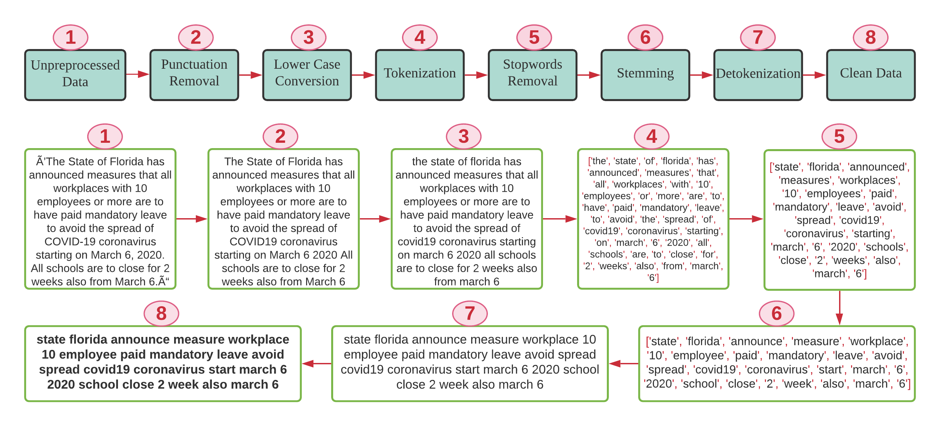
Proposed Approach and Models(cont.)
Data Preprocessing:

Slide 8
Proposed Approach and Models(cont.)
Feature Extraction: One of the challenges of text categorization is learning from high dimensional data. Thus, it is best to perform feature reduction to reduce the text feature. Two different features selection methods are used:
Bag of Words (BoW): It takes each document as input and calculates the number of occurrences of each word in that article, which then generates a numerical representation of the text known as feature vectors of fixed length.
Term Frequency-Inverted Document Frequency (TF-IDF): It is a statistical metric used to measure how important a term is to a document in a dataset. It weights down the term frequency while scaling up the rare ones.

Slide 9
Proposed Approach and Models(cont.)
N-gram Model: N-gram modeling is a popular feature identification and analysis approach used in language modeling and Natural language processing fields.
It is a contiguous sequence of items with length n.
It could be a sequence of words, bytes, syllables, or characters.
In this work, we have used character and word based n-gram to represent the context of the document and generated features to classify the tweets.
The idea is to generate various sets of n-gram frequency profiles from the training data to represent misleading and real articles.

Slide 10
Proposed Approach and Models(cont.)
Classification Process:
In our work, we have compared the performance of five machine learning classifiers, namely, Multinomial Naive Bayes (MNB), Logistic Regression (LR), Decision Tree Model (DT), Linear Support Vector Classifier (LSVC) and K-Nearest Neighbor (K-NN).
We have also checked the performance of three Ensemble strategies known as Gradient Boosting Classifier (GBoost), AdaBoost(AdB) and Bagging.
Finally, we have implemented a Three-Level Voting Model (TLV) architecture to automatically identify news-articles related to COVID-19 and classify them into two groups as ‘misleading’ and ‘real’.

Slide 11
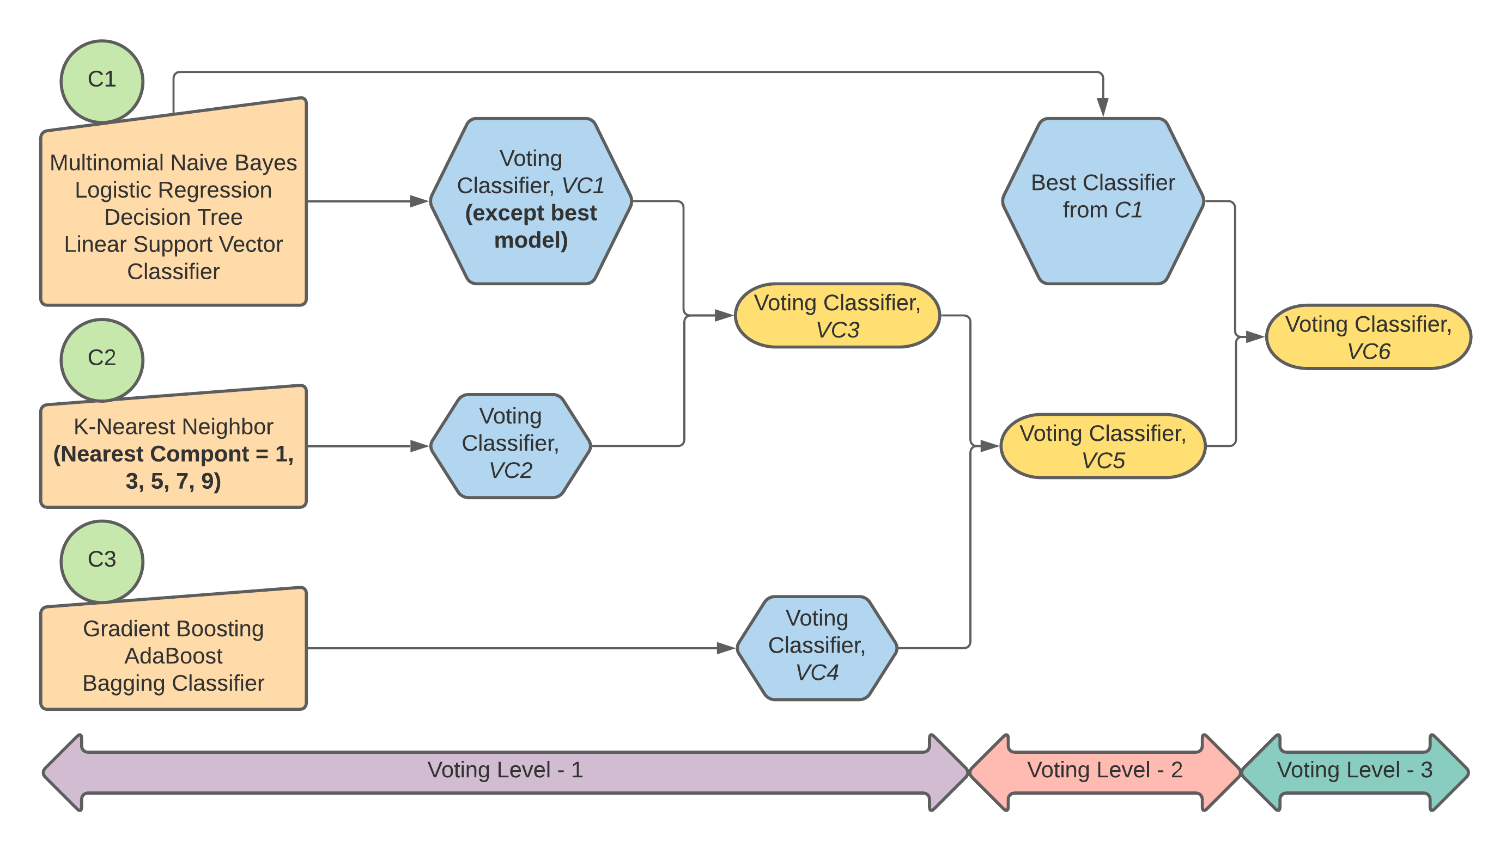
Proposed Approach and Models(cont.)
Classification Process:

Slide 12
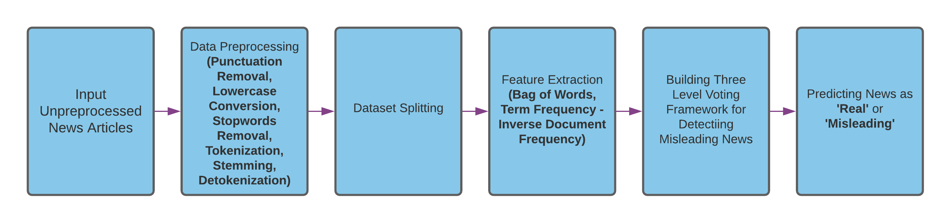
Methodology

Slide 13
Performance Analysis
Three-Level Voting Model (TLV):
We have incorporated similar types of algorithms in the same group which has helped us to preserve the neutrality of the models’ decision.
Multiple voting levels have helped to predict the label of the contents accurately as in each level voting is applied for label identification.
We have achieved 94% accuracy for TLV when ‘BoW’ is used to extract features.
Consideration of TF-IDF (‘Unigram’) for feature retrieval has provided 96% accuracy.
The highest 79% accuracy has been attained for TF-IDF (‘Tri-gram’) feature.
The notable result has been obtained for other features as well.

Slide 14
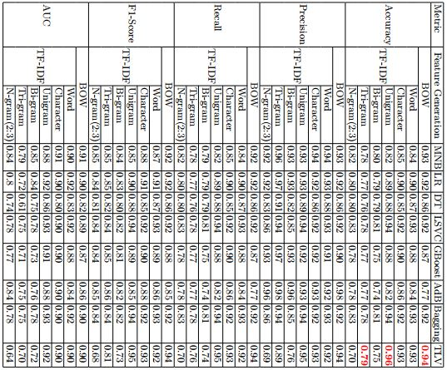
Performance Analysis(cont.)
Comparative analysis of various classifiers based on performance evaluation:

Slide 15
Performance Analysis (cont.)
The existing prediction accuracy varied from 75% to 96% which is overcome in our proposed model with proper validation.
To prevent our model from bias, we have validated our model by applying different cross-validation techniques (K-Fold, Stratified K-Fold, Shuffle Split, Stratified Shuffle Split). (K=10)
We have also achieved 95% accuracy for ‘BoW’ when stratified K-Fold and Stratified Shuffle Split techniques have been utilized.
96% has been obtained for TF-IDF (‘word’, ‘character’) when Stratified shuffle split has been applied.

Slide 16
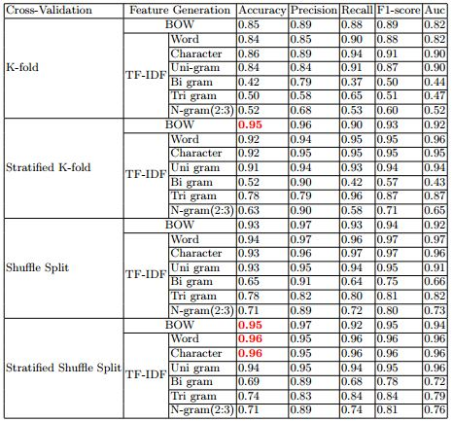
Performance Analysis(cont.)
Performance evaluation of TLV model based on cross-validation techniques:

Slide 17
Conclusion & Future Works
Fake News on Covid-19 is continuously affecting the daily life of mankind either intentionally or unintentionally.
Our proposed TLV model has surpassed general mining techniques by voting in three stages and achieved highest 96% accuracy.
In future, we will apply our model to more diversified datasets.
It would also be great to extend and examine if the proposed model can work for the multi-class classification problem too.
Our suggested models can be applied in other related text classification works for further meaningful analysis.

Slide 18
References
1. Higdon, Nolan (August 15, 2020). ”The Anatomy of Fake News: A Critical News Literacy Education”. University of California Press. Retrieved September 12, 2020.
2. World Health Organization Official Website. Accessed: Mar. 21, 2020.[Online]. Available: https://www.who.int.
3. G. L. H. Teck and C. H. M. Chyong, ”Effects of the coronavirus (COVID-19) pandemic on social behaviours: From a social dilemma perspective,” Tech. Soc. Sci. J.,
vol. 7, no. 1, pp. 312-320, May 2020.
4. V. L. Rubin, Y. Chen, and N.K. Conroy, (2015), Deception detection for news: Three types of fakes. Proc. Assoc. Info. Sci. Tech., 52: 1-4. https://doi.org/10.1002/pra2.2015.145052010083
5. Mohamed Elhadad, Kin Fun Li & Fayez Gebali. (2020). Detecting Misleading Information on Covid-19. 10.1109/ACCESS.2020.3022867.
6. William Yang Wang. ”liar, liar pants on fire”: A new benchmark dataset for fake news detection. arXiv preprint arXiv:1705.00648, 2017.
7. V.L. Rubin, N.J. Conroy, and Y. Chen, (2015). “Towards News Verification: Deception Detection Methods for News Discourse”. In Proceedings of the Hawaii International Conference on System Sciences (HICSS48) Symposium on Rapid Screening Technologies, Deception Detection and Credibility Assessment Symposium, January 5-8, 2015 Grand Hyatt, Kauai [Accessed 6 February 2020].
8. Hadeer Ahmed, Issa Traore & Sherif Saad (2017). Detection of Online Fake News Using N-Gram Analysis and Machine Learning Techniques. 127-138. 10.1007/978-3-319-69155-8 9.
9. Amit Purushottam Pimpalkar & Jeberson Retna Ra, ”Influence of Pre-Processing Strategies on the Performance of ML Classifiers Exploiting TF-IDF and BOW Features.
10. Aswini Thota, Priyanka Tilak, Simrat Ahluwalia and Nibrat Lohia, (2018) ”Fake News Detection: A Deep Learning Approach,” SMU Data Science Review: Vol. 1 : No. 3 , Article 10. Available at: https://scholar.smu.edu/datasciencereview/vol1/iss3/10
11. N. Smitha and R. Bharath, ”Performance Comparison of Machine Learning Classifiers for Fake News Detection,” 2020 Second International Conference on Inventive Research in Computing Applications (ICIRCA), Coimbatore, India, 2020, pp. 696-700, doi: 10.1109/ICIRCA48905.2020.9183072.
12. B. Al Asaad and M. Erascu, “A tool for fake news detection,” in Proc. 20th Int. Symp. Symbolic Numeric Algorithms Scientific Comput. (SYNASC), Sep. 2018, pp.
379–386, doi: 10.1109/SYNASC.2018.00064.
13. M. D. Ibrishimova and K. F. Li, “A machine learning approach to fake news detection using knowledge verification and natural language processing,” in Proc. INCoS, Oita, Japan, 2020, pp. 223–234.
14. L. Cui, D. Lee: CoAID: COVID-19 healthcare misinformation dataset. arXiv preprint arXiv:2006.00885 (2020)
15. P.S. Reddy, D. Roy, P. Manoj, M. Keerthana, & P. Tijare (2019). A Study on Fake News Detection Using Na¨ıve Bayes, SVM, Neural Networks and LSTM.
16. Mykhailo Granik and Volodymyr Mesyura. Fake news detection using naive bayes classifier. In 2017 IEEE First Ukraine Conference on Electrical and Computer Engineering (UKRCON), pages 900–903. IEEE, 2017.

Slide 19
Thank You

